Slide 1
Region VI Strike Team Leader, Single Increment & Overhead Refresher 2017

Slide 2
It is the responsibility of the Overhead*/STL/TFL to always know which agreement was used for your request and what mission (who pays) you were requested for!
THIS IS ON YOU!
Notes:
This starts with an order and a request. If you don’t have one, don’t go. If you have one (and you should be holding it in your hand) it’s on you to know how you’re going out. If you don’t know, ask. If you don’t get an answer, don’t go until you get one. * This includes FEMT, FEMP, and other positions. They most likely will be at the incident after OES has left and need to understand Exhibit H, and F-42 process. Refer to OES Operations Bulletin #8.

Slide 3
AGREEMENTS
Master Mutual Aid (MMA)
State Fire and Rescue Resource Mutual Aid Guidelines Document*
California Fire Assistance Agreement (CFAA)
Local Forest Agreement
California Cooperative Fire Management Agreement (CFMA)
Notes:
A partial list of agreements. You should be familiar with them.
* Old 7 points of light

Slide 4
AGREEMENTS
Master Mutual Aid (MMA)
Generally no reimbursement, no $$$
California Fire Assistance Agreement (CFAA)
Typically involves reimbursement
Local Forest Agreement (LFA)
Whatever you agreed to
Notes:
These are the three that come into play most often. You should be familiar with them and have copies of them in your kit or electronically.

Slide 5
Agreements
State Fire and Rescue Resource Mutual Aid Guidelines Document
(AKA – 7 points of light)
Applies to CAL FIRE resource only
Closest resource for Fixed Winged Aircraft
Notes:
Closest Fixed Winged Resource may not be CAL FIRE. If Fed Resource, you will pay for it.

Slide 6
FOREST AGENCY COMMAND & CONTROL ORDERING SYSTEM
CALIFORNIA FIRE & RESCUE MUTUAL AID SYSTEM
Cal OES Fire & Rescue
Other GACC or NICC
North Ops or South Ops
Regional Command Center
Adjacent Forest or Unit
Operational Area Command Center
Forest Agency
ECC
Local Fire Agency
Notes:
This slide shows the two ordering systems side by side. I discuss the ordering flow in general and describe the mutual aid system here.

Slide 7
FOREST AGENCY COMMAND & CONTROL ORDERING SYSTEM
CALIFORNIA FIRE & RESCUE MUTUAL AID SYSTEM
How and when do you cross the double yellow line?
Cal OES Fire & Rescue
Other GACC or NICC
North Ops or South Ops
Regional Command Center
Operational Area Command Center
Other Forest or Unit
Forest Agency
ECC
Local Fire Agency

Slide 8
CALIFORNIA FIRE & RESCUE MUTUAL AID SYSTEM
Local Government request for Cal Fire resources under the State Fire and Rescue Resource Mutual Aid Guidelines (AKA - 7 points of light)
Typical for an LRA wildland incident
Some non wildland incidents
Involves requests to Cal Fire only
Cal Fire and OES duty officers need to be in the loop
Cal OES Fire & Rescue
Regional Command Center
Operational Area Command Center
Forest Agency
ECC
Local Fire Agency
Notes:
Seven Points of Light has been superseded by the “State Fire & Rescue Mutual Aide Guidelines” letter which can be found on the www.caloes.ca.gov website.

Slide 9
FOREST AGENCY COMMAND & CONTROL ORDERING SYSTEM
Forest agency can make requests to local agency under local agreements
Agreements differ across the state
Makes use of closest resource for IA
Other GACC or NICC
North Ops or South Ops
Other Forest or Unit
Forest Agency
ECC
Local Fire Agency
Notes:
Many times the CFAA agreement language is used to develop these agreements, in fact the current CFAA encourages its use as the basis for the “local agreement”.

Slide 10
FOREST AGENCY COMMAND & CONTROL ORDERING SYSTEM
Once the forest agencies begin to exhaust their resources, or the incident dictates closer resources, then a conscious decision must be made by the IC or ECC expanded to place requests into the California Fire & Rescue Mutual Aid System
Other GACC or NICC
U
T
F
North Ops or South Ops
Other Forest or Unit
Forest Agency
ECC
Notes:
The Forest Agencies may “shop” for resources in their system, which may not be the closest, appropriate resources, but because of financial or management policies may be required to do so. Orders will not be sent to the California Mutual Aid System until directed to do so by the IC or Agency Administrator.

Slide 11
FOREST AGENCY COMMAND & CONTROL ORDERING SYSTEM
CALIFORNIA FIRE & RESCUE MUTUAL AID SYSTEM
Other GACC or NICC
CA MOB GUIDE Mutual Aid: All requests for mutual aid resources begins at the local agency and are made to their respective Fire & Rescue Operational Area Coordinator….
North Ops or South Ops
Other Forest or Unit
Operational Area Command Center
Forest Agency
ECC
Local Fire Agency
Notes:
Once the Forest agencies has decided to request (go into the X box) Local Government, that order should be placed to the Operational Area Coordination Center in which the incident is occurring in. Once the MA “ordering door” has been opened with a OA Coordination Center, and even if the incident moves into another OA, the ordering connection should not change.

Slide 12
The California Fire Assistance Agreement (CFAA)
USFS
NPS
BLM
BIA
CAL OES
CAL FIRE
USFW

Slide 13
CA Fire Assistance Agreement
Reimbursement Rates
Annual Salary Survey required for reimbursement
Base Rates (Overtime component included)
FF: $29.19 hour
STL: $35.87 hour
Unemployment, workers’ compensation
If you have provided your Actual Admin Rate, you are required to update this by July 1 of each year
After this date, the rate will default to 10% base, until an actual rate has been received
Notes:
Salary Survey is required to be updated Annually – An Agency may update more often as changes occur. Salary surveys shall be submitted each year. Failure to do so results in no payment.

Slide 14
Personnel Base Rates: These rates ONLY apply if your agency does NOT have rates on file.
Overhead at or above Strike Team/Task Force Leader: $35.87 per hour.
Engine Company and Overhead at or below
Strike Team/Task Force Leader (Trainee): $29.19 per hour.
Apparatus Rates:
There is a 16-hour maximum allowable charge per 24-hour period from time of dispatch.
GPM Hourly
0001-1000 $70.00
1001-1250 $80.00
1251-1500 $85.00
1501-2000+ $90.00
Support Equipment Rates:
Government Owned Vehicles: Privately Owned Vehicles:
Sedan $47.00 per day $0.535 per mile
Pickup $86.00 per day
Van $109.00 per day
SUV $96.00 per day
Other $96.00 per day (3/4 ton & above)
Notes:
1. 16 hour maximum allowable on apparatus.
That the pump rating plaque is the test of accuracy and survives audit.
That POV’s and Rentals are generally problematic and AOV’s are the best way to go.

Slide 15
CA Fire Assistance Agreement
Actual Administrative Rate Due Date:
Local government fire agencies who prefer to develop an actual administrative rate, are required to develop and submit a new rate by July 1, of each year.
Failure to submit each year before this date, will default your agency to the base administrative rate set annually each year by the committee (The rate is 10%).
Notes:
The rate will need to accompany a signed salary survey including the rate and the administrative rate calculation sheet is required and now part of the salary survey.

Slide 16
CA Fire Assistance Agreement
Definitions for personnel hours
PORTAL TO PORTAL shall mean the time of initial dispatch from home base to the time of return to home base.
ACTUAL HOURS WORKED shall mean on shift time which includes a specific start and ending time, and is recorded as clock hours. On shift time includes actual work, order stand-by and compensable travel. Individuals are required to report to their designated work site as scheduled, ready and willing to perform work safely.

Slide 17
CA Fire Assistance Agreement
Memorandum of Understanding (MOU), Memorandum of Agreement (MOA), Governing Body Resolution (GBR) or Equivalent:
Any agency seeking reimbursement for personnel for more than actual hours worked on an incident (PORTAL TO PORTAL) must file an MOU/MOA/GBR or equivalent with Cal OES. The MOU/MOA/GBR or equivalent shall indicate how personnel will be compensated.

Slide 18
CA Fire Assistance Agreement
Memorandum of Understanding (MOU), Memorandum of Agreement (MOA), Governing Body Resolution (GBR) or Equivalent (cont.):
Must submit to Cal OES prior to dispatch.
If the local agency does not submit an MOU/MOA/GBR or equivalent prior to dispatch, the F-42(s) will be processed, and the local agency will be paid for ACTUAL HOURS worked.

Slide 19
CA Fire Assistance Agreement
Memorandum of Understanding (MOU), Memorandum of Agreement (MOA), Governing Body Resolution (GBR) or Equivalent for Chief Officers:
Personnel above the Battalion Chief level that have an MOU/MOA/GBR or equivalent that indicates they are to be paid above straight time must have the associated document on file prior to dispatch to receive full reimbursement for associated personnel cost.
Notes:
If your MOU/MOA/GRB is set to expire and your agency is still in bargaining, you must submit a letter of explanation to CAL OES stating so to continue with prior MOU/MOA/GBR (contractual/guidelines).

Slide 20
CA Fire Assistance Agreement
Memorandum of Understanding (MOU), Memorandum of Agreement (MOA), Governing Body Resolution (GBR) or Equivalent (cont.):
Any MOU/MOA/GBR or equivalent is subject to review by the Committee.
Local government will be formally notified by Cal OES of the determination.
If your agency submits an MOU/MOA/GBR, only the full complete MOU /MOA/GBR will be accepted. No partial documents will be reviewed.

Slide 21
CA Fire Assistance Agreement
Memorandum of Understanding (MOU), Memorandum of Agreement (MOA), Governing Body Resolution (GBR) or Equivalent (cont.):
When submitting a numerous page document for review, it’s important to point out and identify the type of language the document is intended to cover and where the language is located.

Slide 22
CA Fire Assistance Agreement
Memorandum of Understanding (MOU), Memorandum of Agreement (MOA), Governing Body Resolution (GBR) or Equivalent exclusion:
Any agency seeking reimbursement for its Supplemental Personnel will accept rates as outlined in NWCG#2004-2009, Attachment D, which states that Supplemental Personnel will be reimbursed using General Schedule tables with locality pay applied for actual hours worked.

Slide 23
CA Fire Assistance Agreement
Federal/Department of Defense/Tribal Fire Departments:
Reimbursement of Federal, DOD, and Tribal Fire Departments that respond to Federal Fire Agency fires are governed by other federal agreements. In these cases Cal OES will not produce or process reimbursement invoices for DOD and Tribal Fire Departments.
Federal and DOD Fire Departments responding under this Agreement will invoice the supported Federal Fire Agency directly in accordance with existing federal and local agreements.

Slide 24
CA Fire Assistance Agreement
Tribal Fire Departments:
Tribal Fire Departments responding to federal fires under this Agreement will invoice the BIA directly in accordance with existing federal or local Agreements.
Tribal Fire Departments that have a compact or contracted wildland fire program from BIA will respond through the Federal Dispatching System and not through the California Fire and Rescue Mutual Aid System.

Slide 25
CA Fire Assistance Agreement
Tribal Fire Department exception:
HOWEVER, BIA and Cal OES have mutually agreed to informally allow tribal fire departments that would prefer Cal OES to process and generate invoices on behalf of their department to submit a request to both organizations requesting this process be documented for further billings/reimbursement.

Slide 26
How much does this cost?
A typical Engine Strike Team runs from $25,000 to $40,000 per 24 hour period.
If you were a business running these kinds of receipts daily, how accountable would you be for it?
The F-42 is the reimbursement document for this revenue.
Notes:
Self explanatory

Slide 27
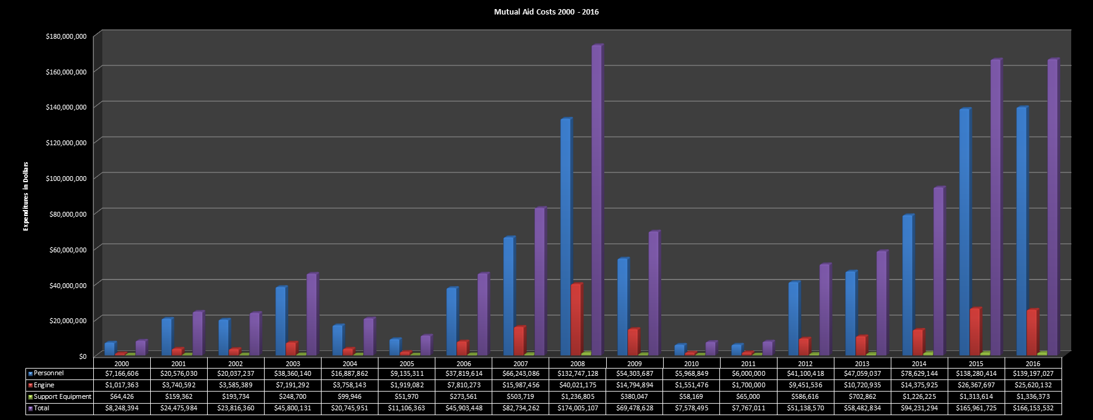
How much does this cost?
Sacramento Metro 167 m Kern County 118 m Fresno City 56 m
Riverside City 52 m San Diego 218 m Santa Barbara 56 m
Ventura 126 m Hunnington Beach 46 m Santa Clara Co 96 m
Menlo Park 37 m Long Beach 92 m San Rafael 21 m
Notes:
This slide illustrates the economics of the cost associated with CFAA reimbursements as compared to the 2017 annual budgets of California Fire Departments.

Slide 28
Some things to know about the CFAA
Reimbursement for emergency apparatus loss or damage:
The State of California and the Federal Fire Agencies may reimburse California Fire and Rescue Mutual Aid System Agencies providing resources through the California fire and Rescue Mutual Aid System for the cost of emergency apparatus or equipment loss or damage where the loss or damage is directly attributable to the incident and where the local agency, its employees and/or operational failures in the emergency apparatus or support equipment are not a contributing factor to such damage or loss. Loss or damage to a local agency emergency apparatus or support equipment while traveling to or from an incident and repairs due to normal wear and tear or due to negligent or unlawful operation by the operator shall be the responsibility of the local agency providing the emergency apparatus or equipment
Notes:
Cover the exclusions of damage or loss of equipment and that the process for both is arduous, time consuming and has to be done correctly in order to be reimbursed.

Slide 29
Some things to know about the CFAA
Travel Expenses: At no time will the California Fire and Rescue Mutual Aid System Agencies seek reimbursement for travel expenses such as fuel, food, and lodging responding to, during, or returning from a Sate of California or Federal Fire Agency incident unless documented and approved in writing by the incident. Regarding APPROVED travel expense reimbursement refer to Exhibit H
Notes:
I usually have a conversation about the strike team who got gas in town because the fuel line in camp was too long. I also talk about no fuel in camp and the exception to buying fuel in town. AND GETTING PRIOR APPROVAL.

Slide 31
Some things to know about the CFAA
Reimbursement – Approved Personal Rotation: Personnel under this agreement are expected to be available a minimum of 7 days (portal to portal) excluding travel, before needing replacement, regardless of the number of assignments from original dispatch.
Some Operational Areas have agreed to a 14 day commitment on assignments exclusive of travel.
Notes:
I remind Region V strike team leaders that they very well might have a mix bag of resources from out of the region and they will have to deal with this issue.

Slide 32
Approved Personnel Rotations
The Incident Commander or MOB Center Mgr to which the resources are assigned must approve the personnel rotation and method of transportation. Such approval should not be denied without substantial cause. (Imminent planned release 24-36 hours or a negotiated extension through the OES AREP).
Must be documented on a ICS-213, signed by the IC through the OES AREP.
Notes:
I talk about the likely hood of no OES AREP being there.

Slide 33
Approved Personnel Rotations
Documentation in ROSS is required if transportation for personnel rotation will be reimbursed
Rotations must be approved by the incident prior to movement of crews
Incident will create an additional subordinate number (e.g. E-75.7, E-75.8) for EACH vehicle used to transport crews
Notes:
This comes from the buses used to transport entire strike teams

Slide 34
Personnel Rotations
Approved rotations without a vehicle will not require a subordinate number
Personnel rotations that are done without a subordinate number will not be reimbursed for their vehicle
F-42s must be clear and complete when documenting rotations
Notes:
Discuss documentation standard and process with the group

Slide 35
Personnel Rotation Issues
Unapproved rotations involving change in ranks on engine are not documented by date/time
Change in number of personnel on engine
Personnel changes not completed prior to reassignment to another incident
Unclear documentation
Notes:
Ex. Water tender with daily rotation of crews at different ranks only indicated “Crew Rotation” on date – not time.
Story about a crew change that started on the Ponderosa Incident and finished on the Bagley Incident. If you don’t complete your crew rotation on one incident, the other incident is not responsible for finishing it.

Slide 36
IMT/Overhead Rental Car
Rental vehicles authorized on the resource order do not need additional incident approval. The cost of the rental vehicle, if incurred by the local agency, and the fuel purchased to operate the rental vehicle must be submitted on the In State Travel and Incident Related Expense Log with receipts taped or photo copied. Rental vehicles that are not authorized on the resource order must receive the formal written approval from the incident as identified above. Exhibit H
Notes:
Anyone renting vehicles or on teams using CFAA should review Exhibit H

Slide 37
IMT/Overhead Rental Car
State contract with Enterprise is available to all local government fire entities
Enterprise will set up a direct bill account for your agency
Users can use a department credit card or
agencies can use account number XZCAFIR
ROSS order must have rental vehicle authorized
Notes:
Anyone renting vehicles or on teams using CFAA should review Exhibit H

Slide 38
IMT/Overhead Rental Car
Steps to obtain a rental car are:
Go on line and get a reservation
Provide your agency account code or credit card, or account number provided by Enterprise on previous slide
Drivers license
ROSS order must have rental vehicle authorized
Notes:
Anyone renting vehicles or on teams using CFAA should review Exhibit H

Slide 39
State of CA Program Rates-Short Term
Class Type | Sample Vehicle | Daily Rates | Weekly Rates
Compact | Nissan Versa | $33.00 | $132.00
Mid-Size/Intermediate | Hyundai Elantra | $33.00 | $132.00
Standard | Buick Verano | $35.00 | $140.00
Full Size | Nissan Altima | $35.00 | $140.00
Hybrid Electric/Plug-In Zero Emission Vehicle | Toyota Prius | $42.00 | $168.00
Compact SUV | Jeep Renegade | $56.00 | $224.00
Medium SUV | Hyundai Santa Fe | $88.00 | $525.00
Pick Up Truck | Ram 1500 | $70.00 | $280.00
¾-Ton/1-Ton Pick Up Truck | Chevy Silverado | $90.00 | $450.00
Mini Van | Dodge Grand Caravan | $56.00 | $224.00
Mini Van (8 Passenger) | Toyota Sienna | $91.00 | $480.00
Large Van (12-15 Passenger) | Ford Transit Wagon | $121.00 | $726.00
Cargo Van | Ram Promaster City | $80.00 | $400.00
Mini-Cargo Van | Transit Connect | $66.00 | $330.00
15’ Cutaway Box Van w/ramp |  | $70.00 | $350.00
16’ Box Truck |  | $85.00 | $425.00
24’ Box Truck |  | $100.00 | $500.00
26’ Box Truck |  | $100.00 | $500.00
14’ Stake Bed |  | $85.00 | $425.00
24’ Stake Bed |  | $100.00 | $500.00

Slide 40
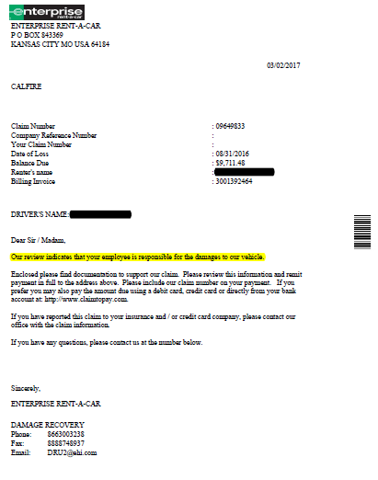
Notes:
The review indicated that the “Agency” is responsible for the damage to the vehicle.

Slide 41
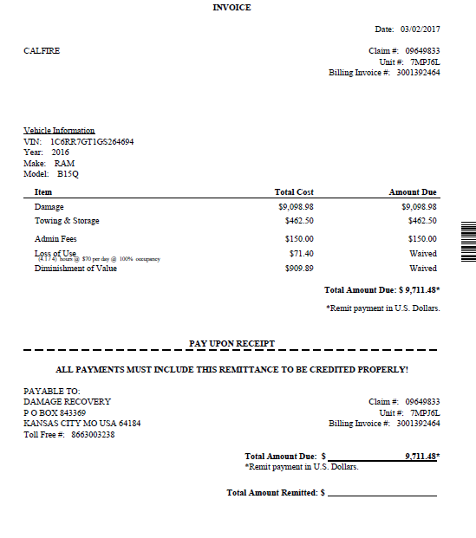

Slide 42
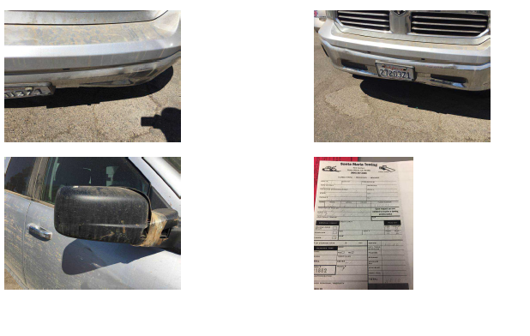

Slide 43
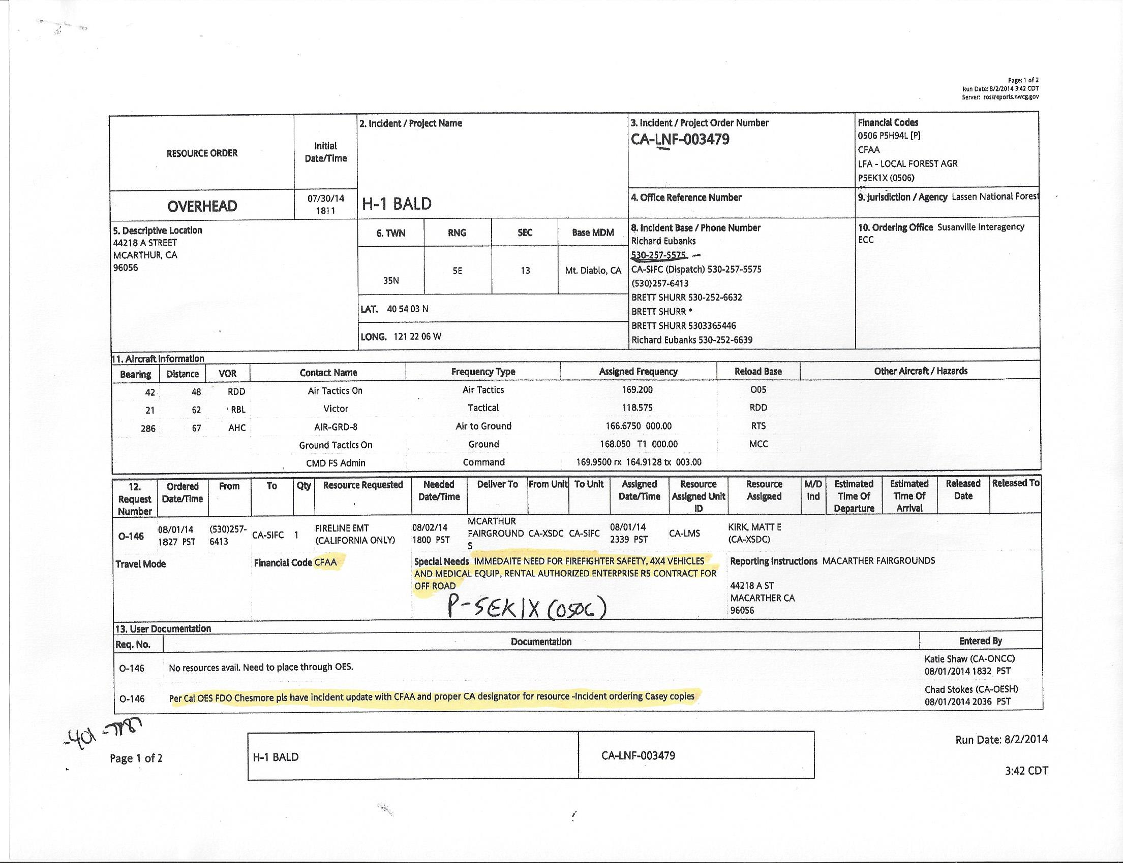

Slide 44
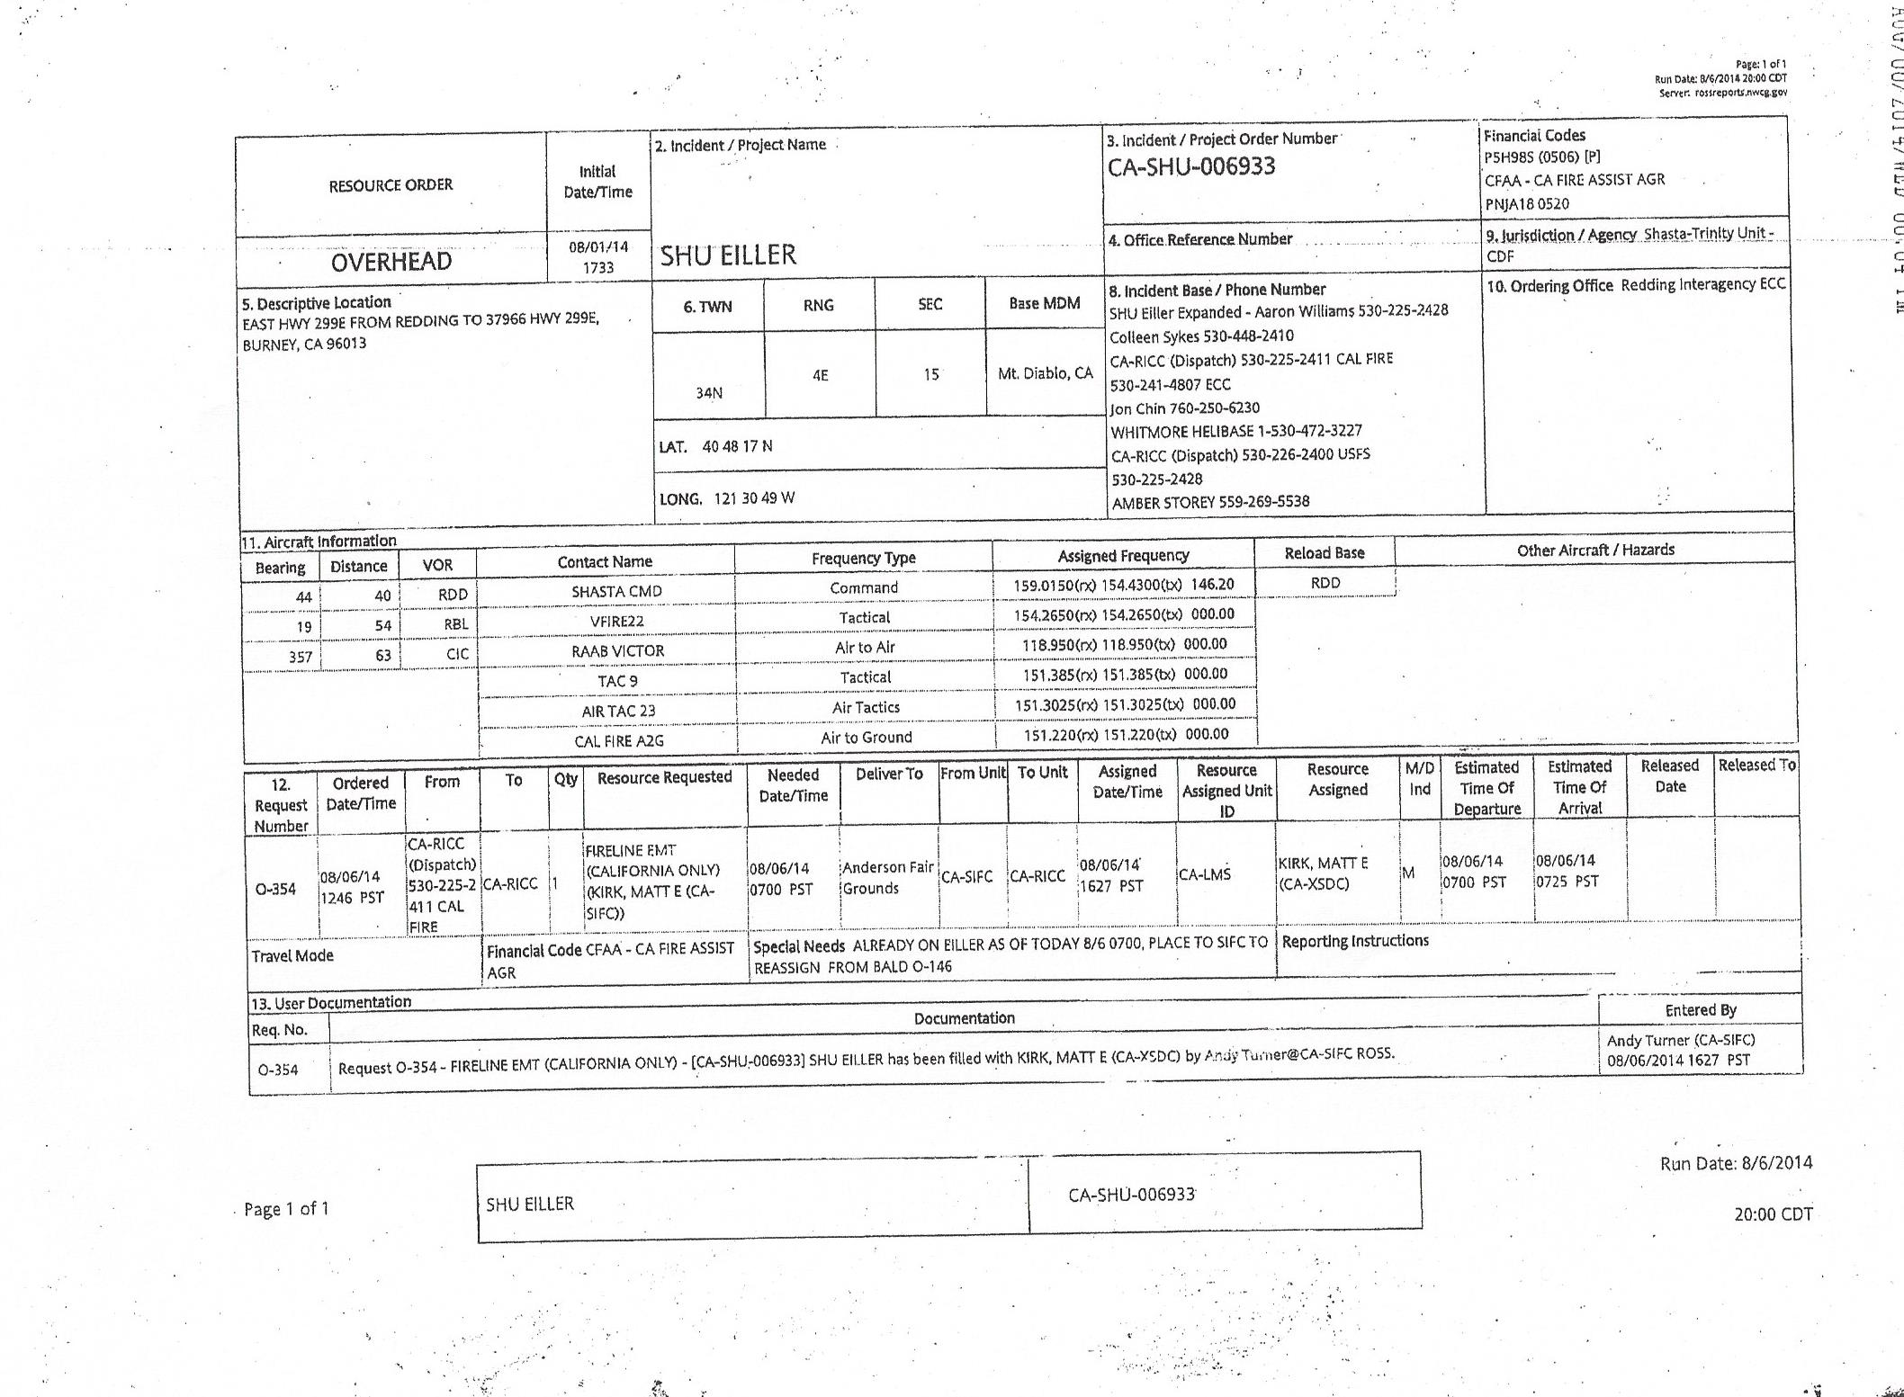

Slide 45
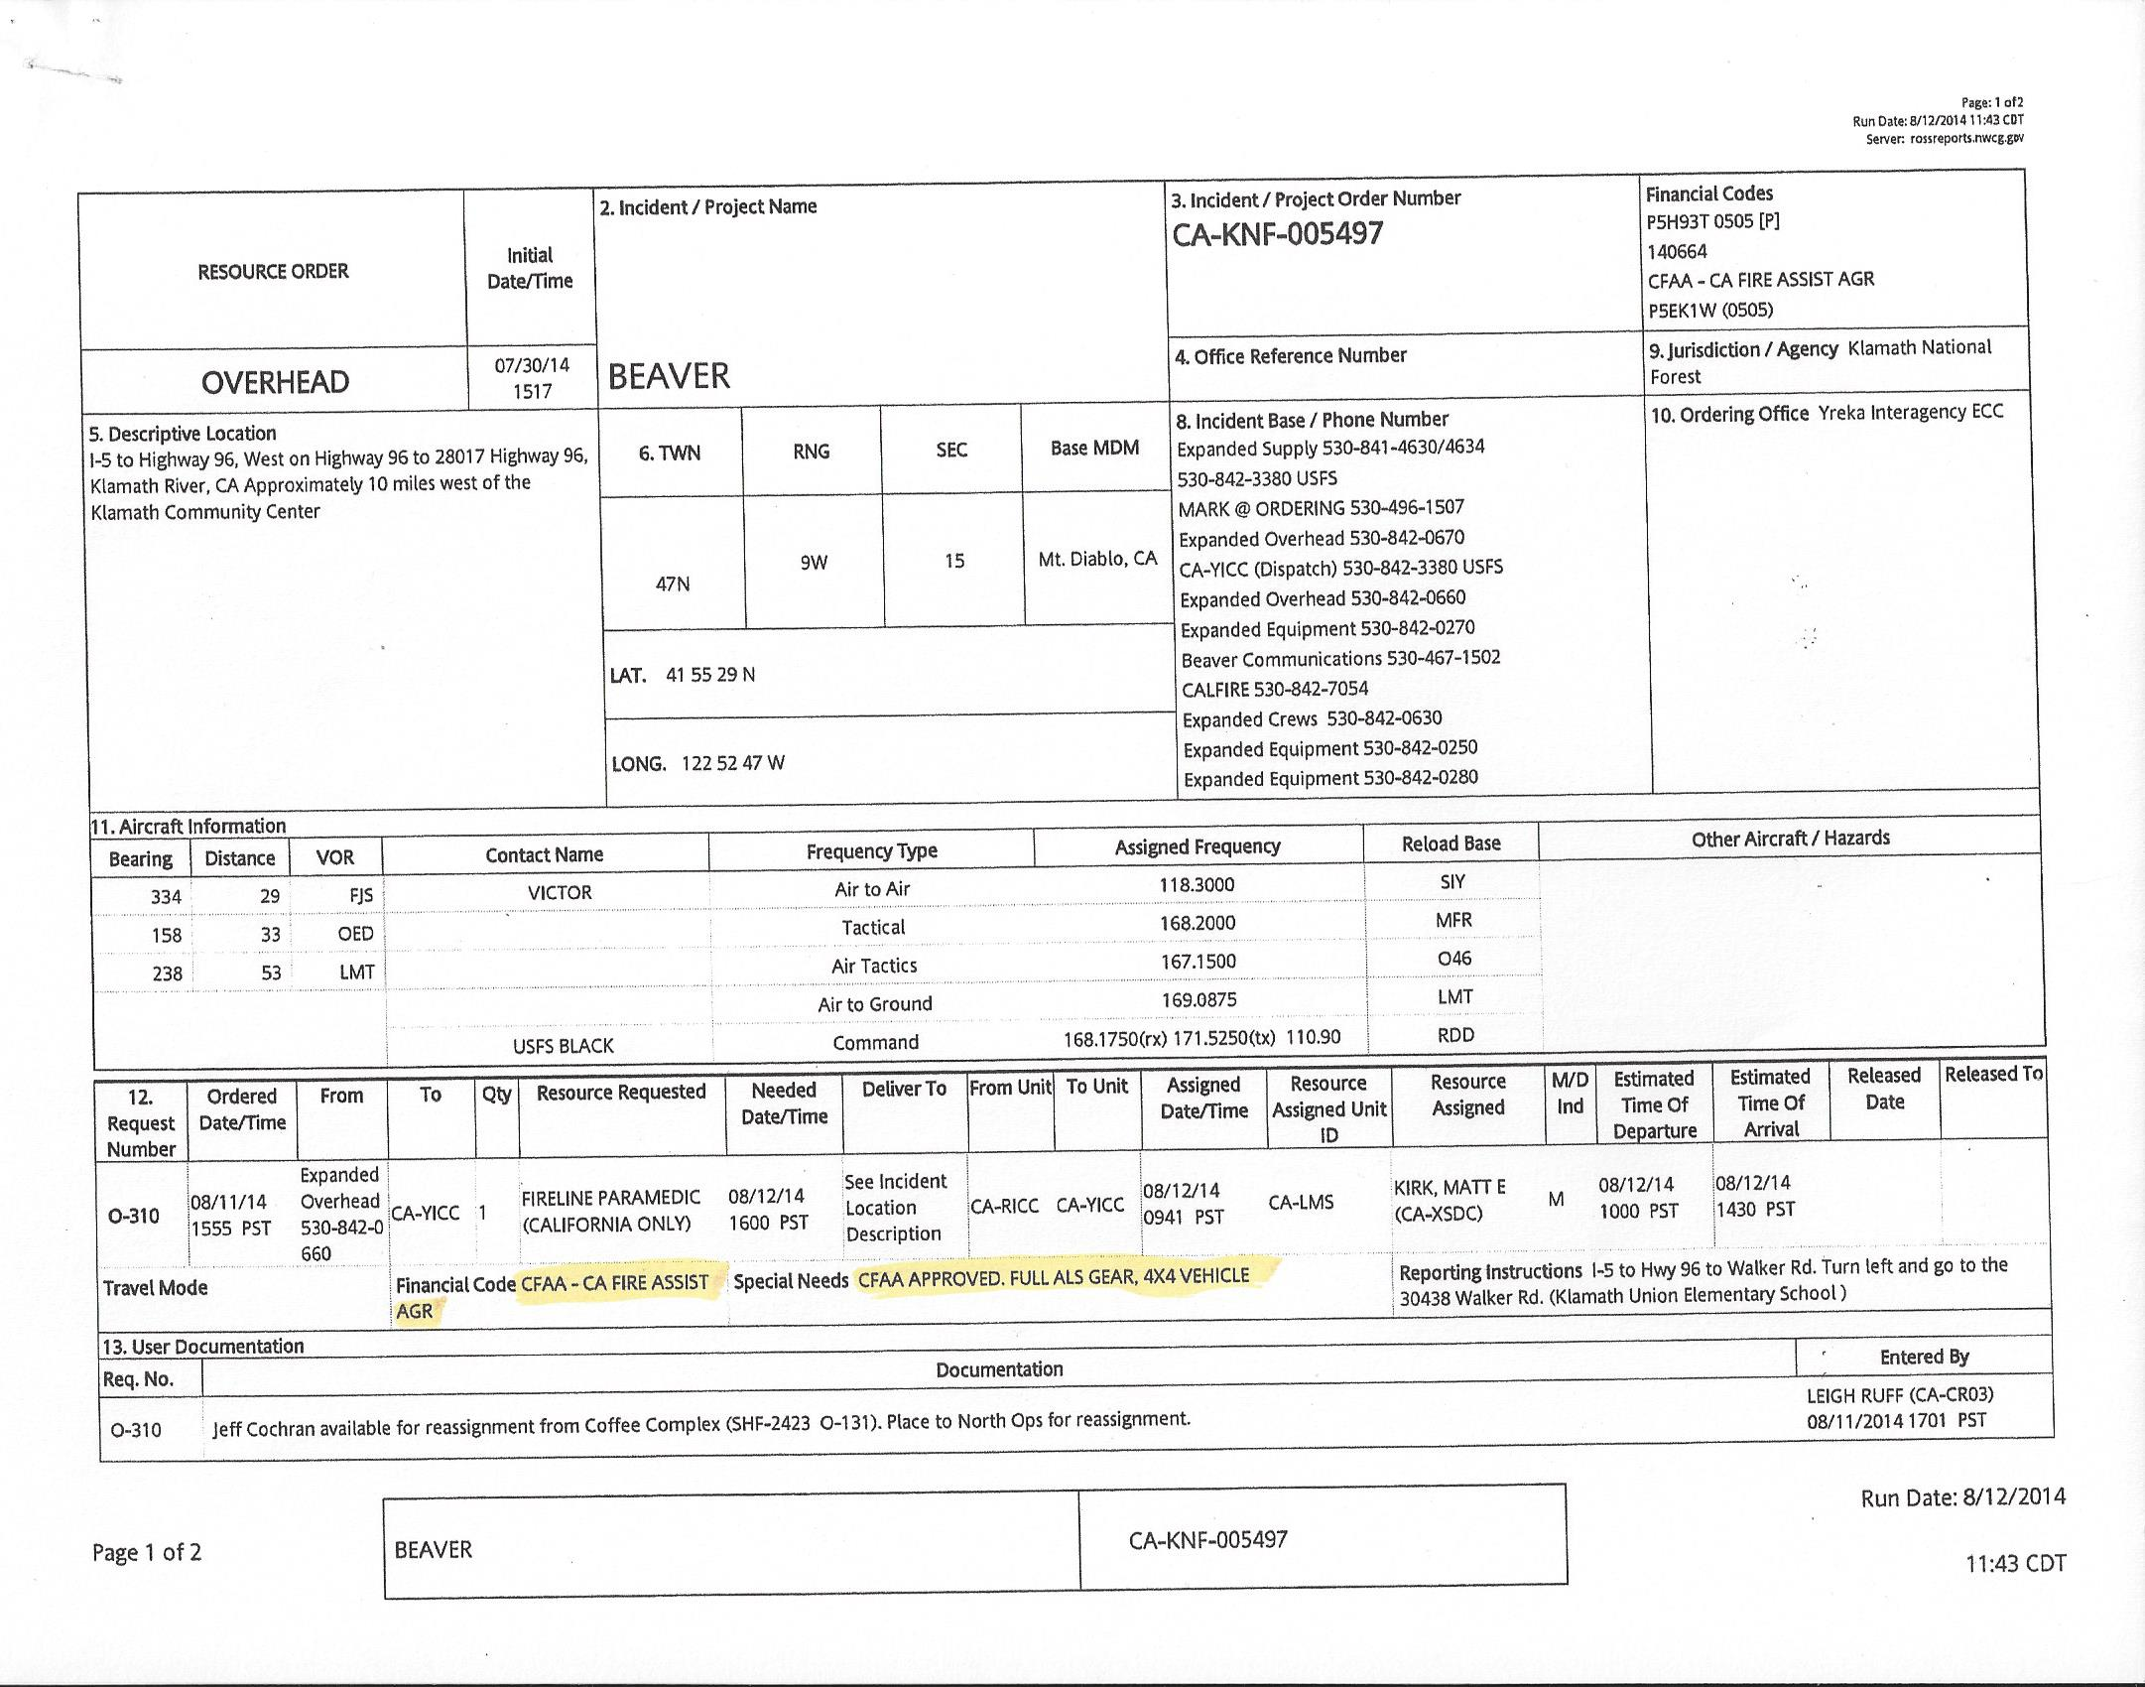

Slide 46
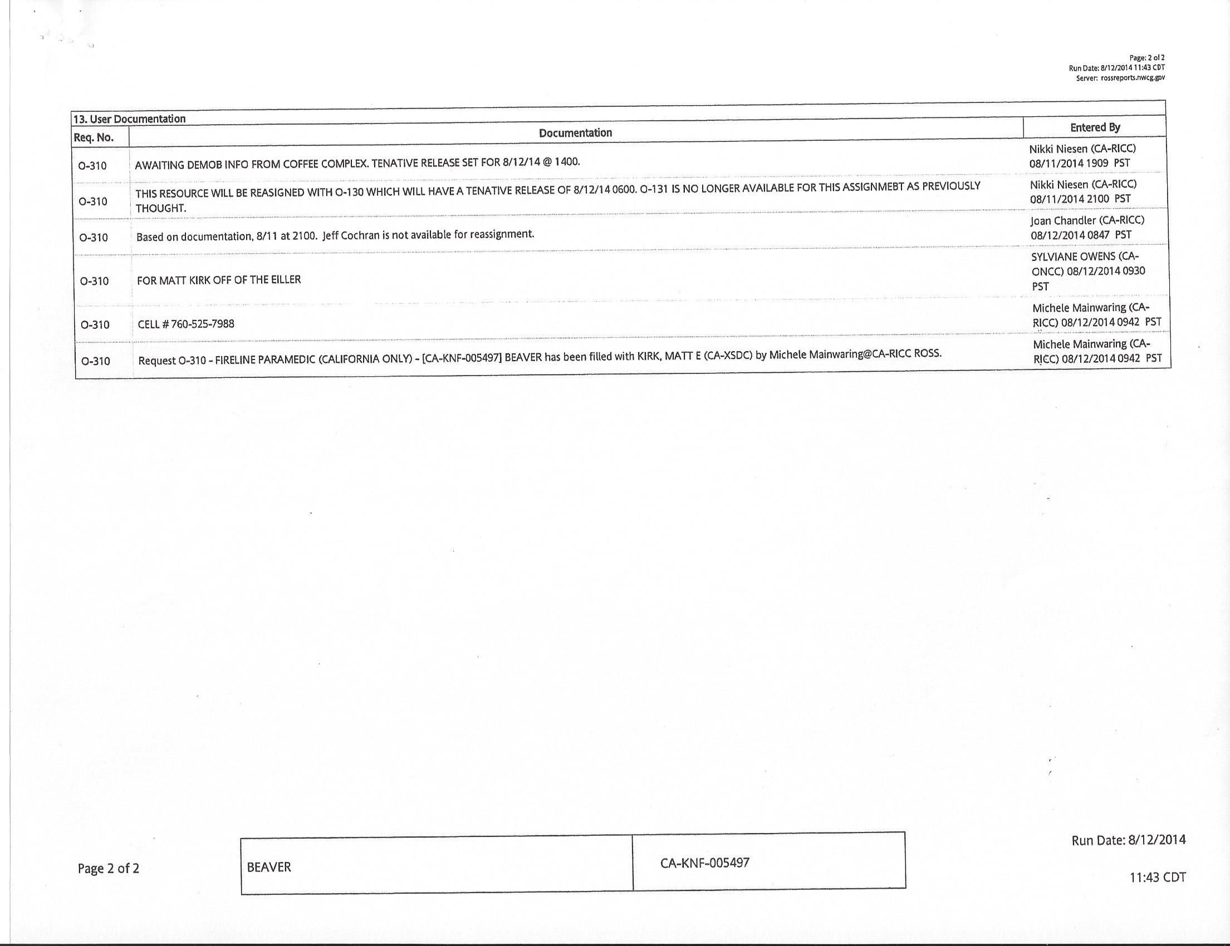

Slide 47
CFAA Responder Types
Suppression: Personnel who routinely respond to emergencies.
Non-Suppression: Personnel who occupy a civilian position within a Fire Agency.
Notes:
Suppression include rates on face page of Salary Survey.
Non Suppression: Dispatchers, GIS, Mechanics, IT folks, Radio Techs are examples of non suppression. Include rates on the salary survey attachment A.

Slide 48
CFAA Responder Types
Supplemental: Overhead tied to a local Fire Department generally by agreement who are mobilized primarily for response to incidents/wildland fires outside of their District or Mutual Aid zone. They are not a permanent part of the local fire organization and are not required to attend scheduled training/meetings, etc., of the Department staff
Notes:
Follows GSA rate of pay per ICS title not Rank. Include rates on salary survey Attachment B.

Slide 49
F-42 tips
Terms to avoid:
Structure protection
Terms to use:
Approved Personnel Rotation
Assigned
Re-assigned
Structure Defense
Any term used in the IAP
Notes:
I joke about the new acronym (OTF) Organized Timber Feature.

Slide 50
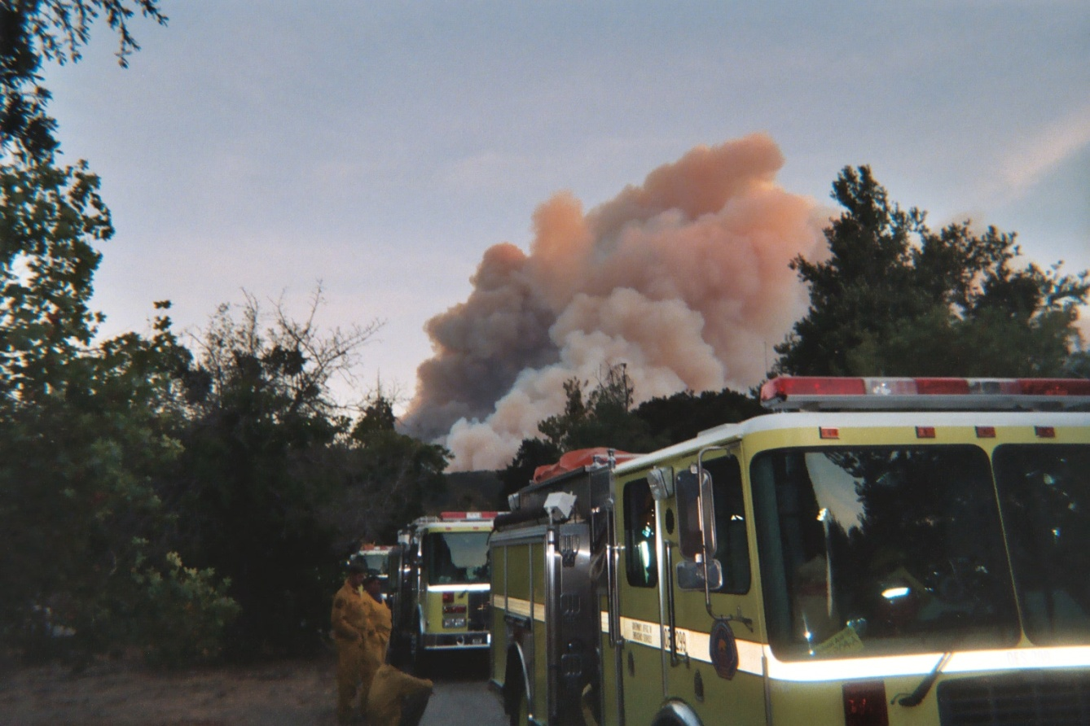
OES Engine S/T Differences
State resources
Come with Voyager cards
Inventories required at Demob.
OP/ Bulletin 41
Notes:
Discuss the issue of cross staffing engines with personnel from different departments. Discuss Tolls and Bridges

Slide 51
Work / Rest Guidelines
To maintain safe, productive incident activities, all personnel must appropriately manage work/rest periods, assignment duration, and shift length for crews, overhead personnel, and support personnel. Plan for and ensure that crews, overhead personnel, and support personnel are provided a 2 to 1 work to rest ratio (for every 2 hours of work or travel, provide 1 hour of sleep and/or rest).
12 hour shift = 6 hours sleep
24 hour shift = 12 hours sleep
Notes:
If an incident wants to challenge the work rest issue, I usually start by showing the logos on the cover of the Mob Guide, then ask that we complete the conversation with Safety involved. It always stops there.

Slide 52
Incident Off-Shift Rest & Sleeping Accommodations
The responsible Forest Agency will provide, when practical, shaded and/or climatically maintained accommodations for off shift sleeping, rest, and recuperation for local government resources confined to incident base

Slide 53
Incident Off-Shift Rest & Sleeping Accommodations
If the Incident Command finds it operationally feasible (i.e. Strike Team remains available), to place local government resources in a commercial sleeping accommodation, it may be provided by the forest agency.

Slide 54
Incident Off-Shift Rest & Sleeping Accommodations
Local government and OES engines staffed by CAL FIRE personnel fall under the provisions of the CFAA
Never split up the strike team
Utilize the OES and CAL FIRE AREP to resolve issues

Slide 55
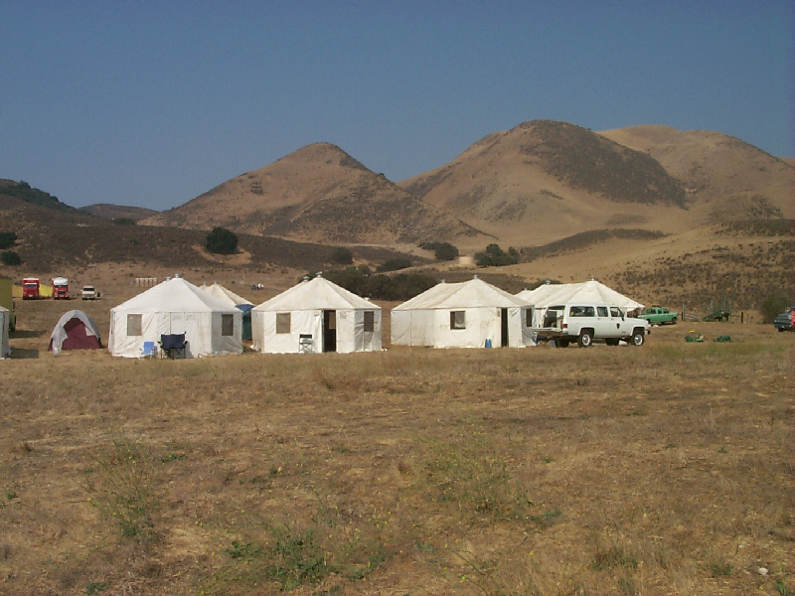
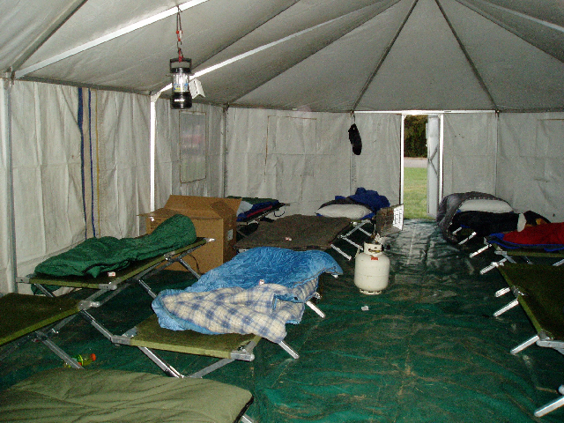
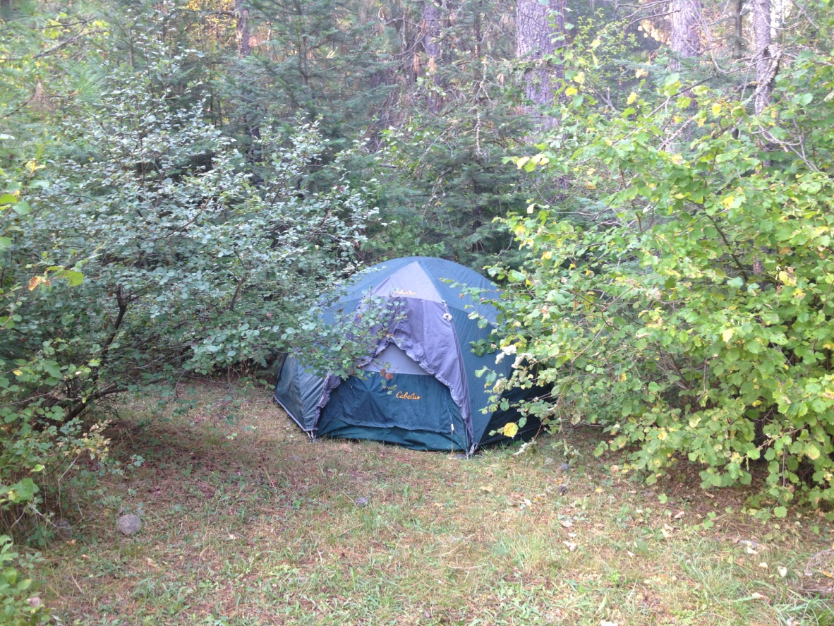
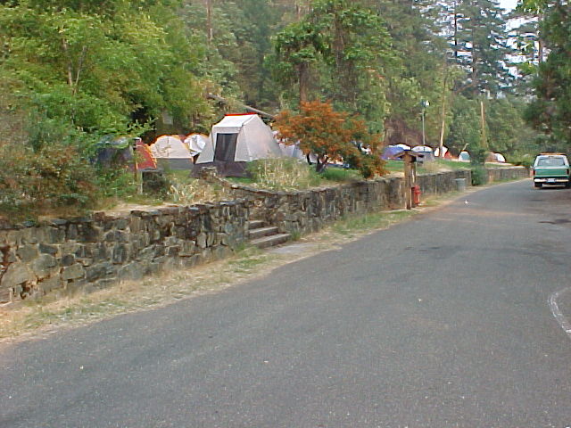
Notes:
Climate Controlled Sleeping Accommodations?

Slide 56
Mobile Sleep Trailers

Slide 57
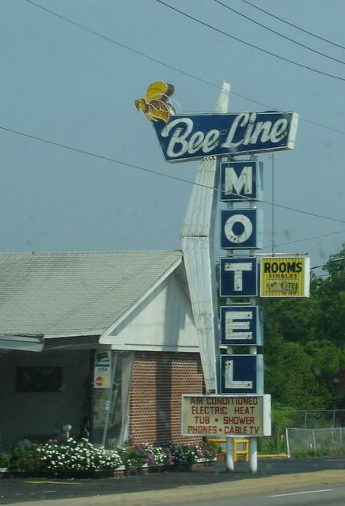

Slide 58
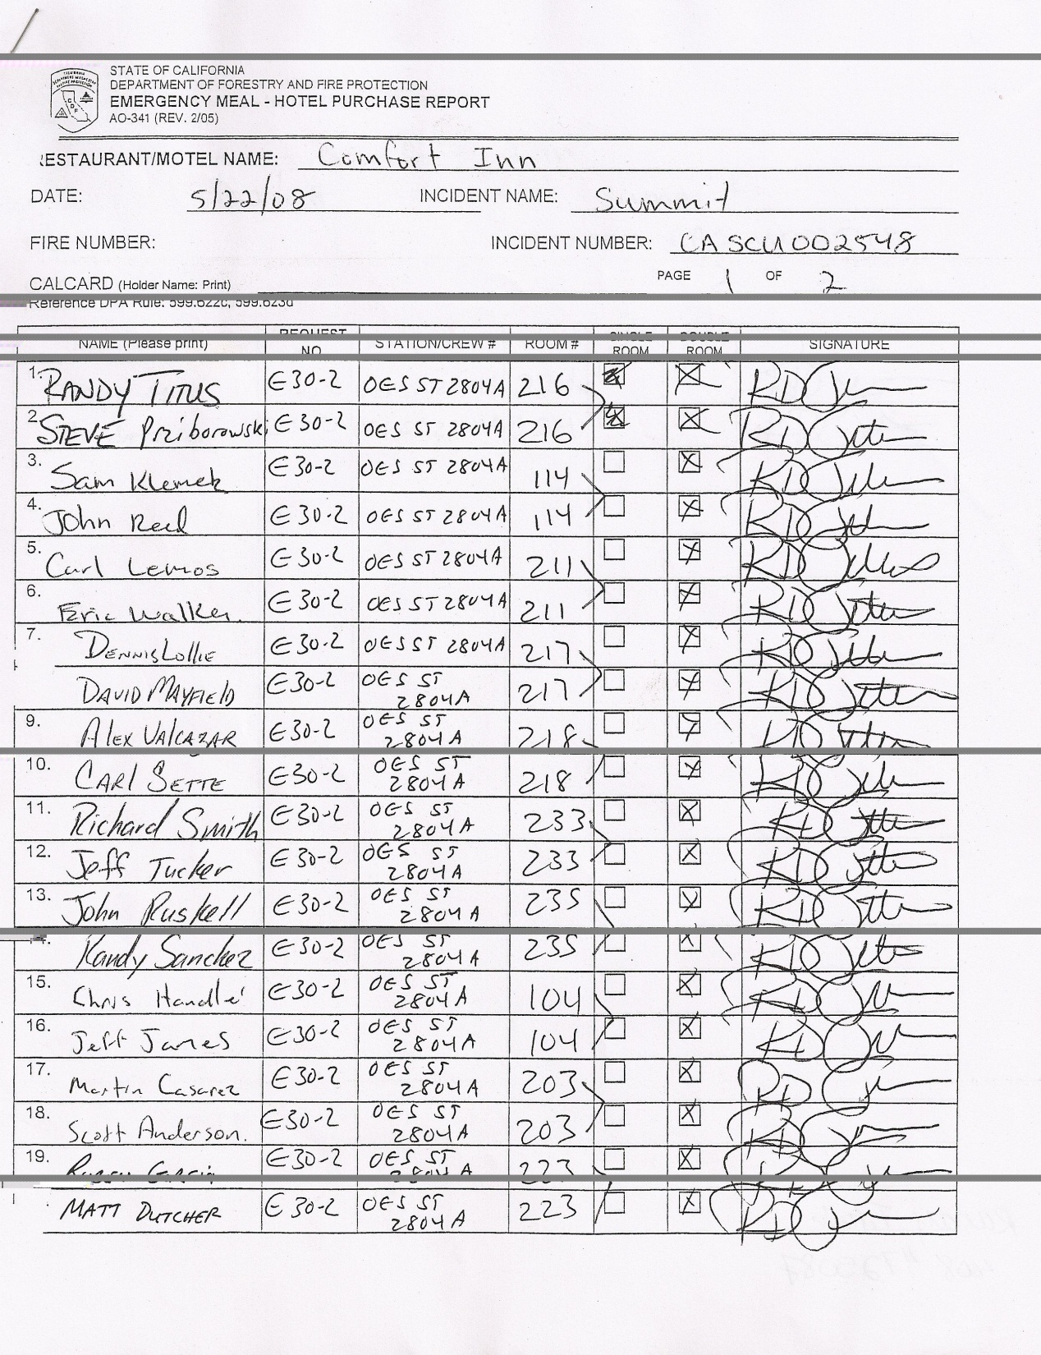
Each person occupying
rooms must sign the CAL FIRE
AO-341 (blue ink) so the bill
can be paid.
Remember that you are still
on the clock, representing
your department and OES.
Mistakes and errors in judgment
you make here will impact the
entire California Fire Service.

Slide 59
Time Unit
Check with the OES AREP for process
If NO OES AREP
Be sure to get your F-42 signed by the incident authorized representative, and mail white copies to OES HQ
Keep your paperwork current

Slide 60
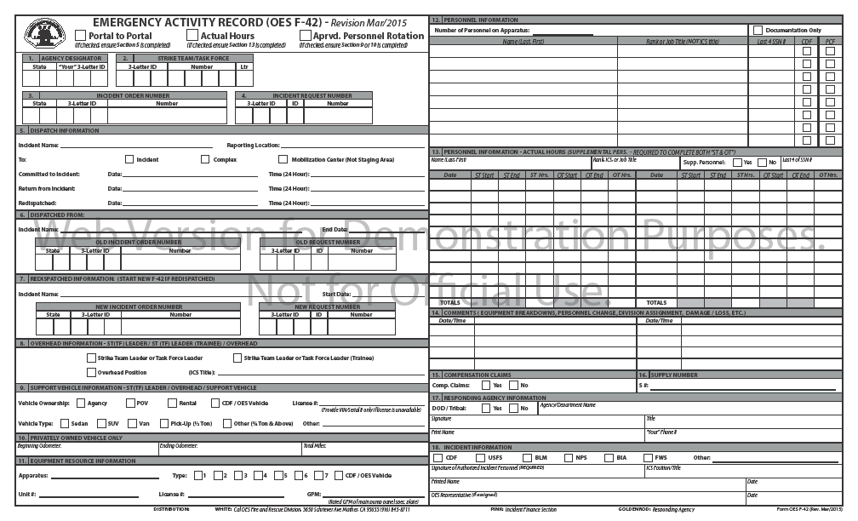

Slide 62
X
S
D
6
4
1
2
C
E

Slide 64
X
S
D
6
4
1
2
C
E

Slide 65
X
S
D
6
4
1
2
C
E
07/16/2015
18:30
E
O

Slide 66
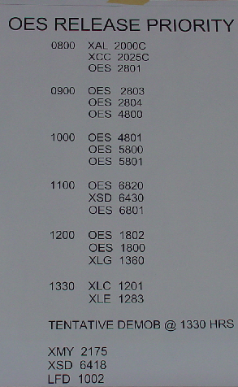
Demobilization
Be familiar with the demob plan
The ICS Form 221 start’s the release process
Follow the steps
Don’t shortcut, be prompt, be
patient
Once ICS Form 221 is complete, status is pending until released or
reassigned

Slide 67
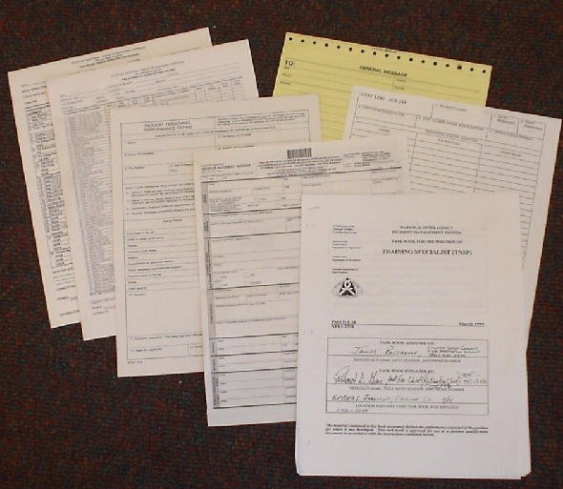
Other Documentation
Taskbooks
ICS-225
Yourself
Company Officers
Inventories
STD Form 270
Notes:
STD Form 270 – Accident Report (If applicable)

Slide 68
State Vehicle Accident Report STD Form 270
State Vehicle Accident Report (STD-270) this form can be located on the DGS website under forms
Description of damages
Narrative and diagram of the accident
Assignee should request police report if needed. (Injuries or damage over $500.00 per state vehicle code.)
If on assignment, notify Strike Team Leader and Liaison, including Safety Officer for additional documentation.
Report needs to be received by Cal OES Fire and Rescue Division within 48 hours

Slide 69
XXXXXXXXXXXX
XXXXXXXX
XXXXXX
Notes:
Make sure you fill in all sections of the forms

Slide 71
Provide photos of damaged apparatus

Slide 74
Compensation/Claims “S” Number Process
Damage to apparatus, equipment, hose left on the line, hose burned are only some examples of items that may be involved in this process
There are steps that need to be followed to ensure that you are compensated for these losses
Failure to complete these processes will very likely result in a denial

Slide 75
Comp/Claims Process
How to you validate whether your claim is covered?
CFAA Page 6 and 7; #25 thru #28
“Reimbursement for Emergency Apparatus Loss or Damage
CFAA Exhibit “H”
“In-State Travel and Incident Related Expenses”
Check with the OES AREP
916-845-8911 Duty Officer
Notes:
Travel expense and Incident Related Expenses. Remember form is used for BOTH

Slide 76
Comp/Claims Process
Complete formal documentation
Accident Report STD Form 270
Complete including diagrams, statements, witnesses
ICS Form 213
Describing event or circumstance
Signed by DIVS, Branch or immediate supervisor
Photos
Include plate, vin plate, door logo, damage
Date and time stamped helps
On thumb drive for electronic distribution

Slide 77
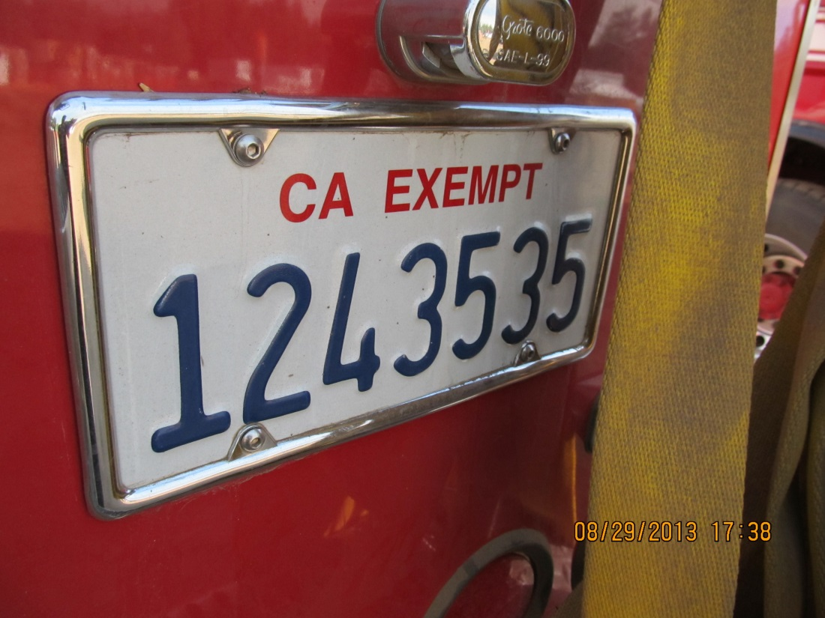
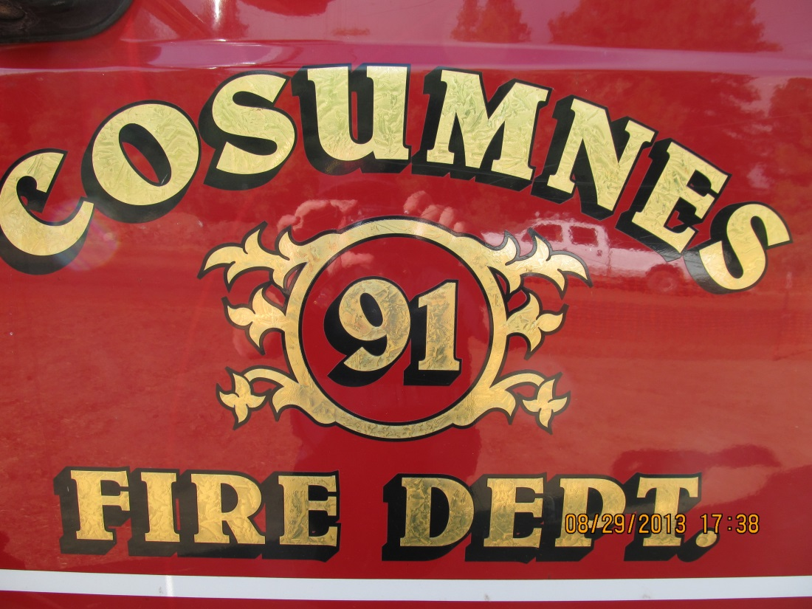
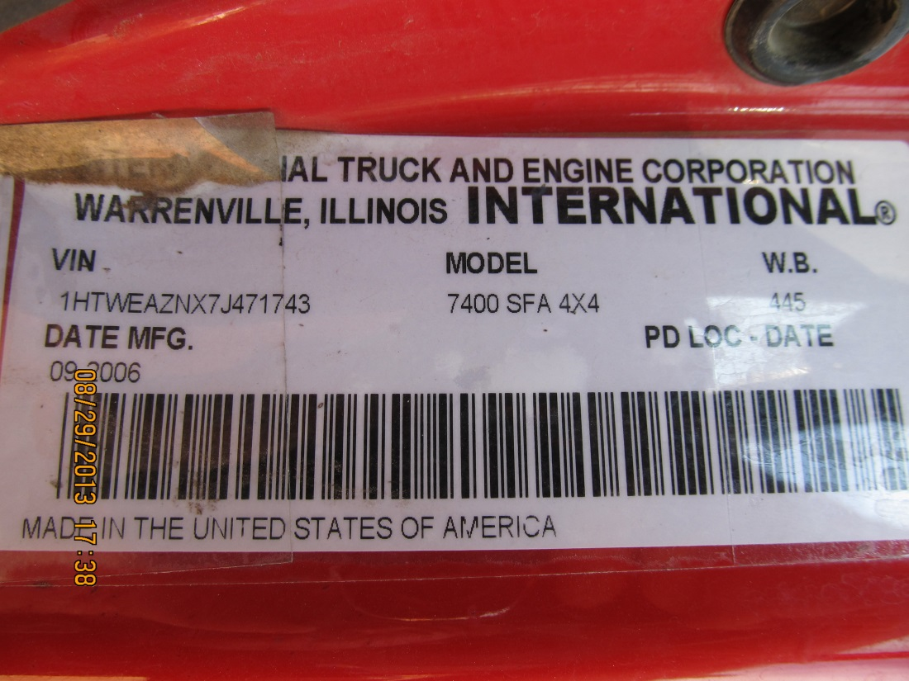
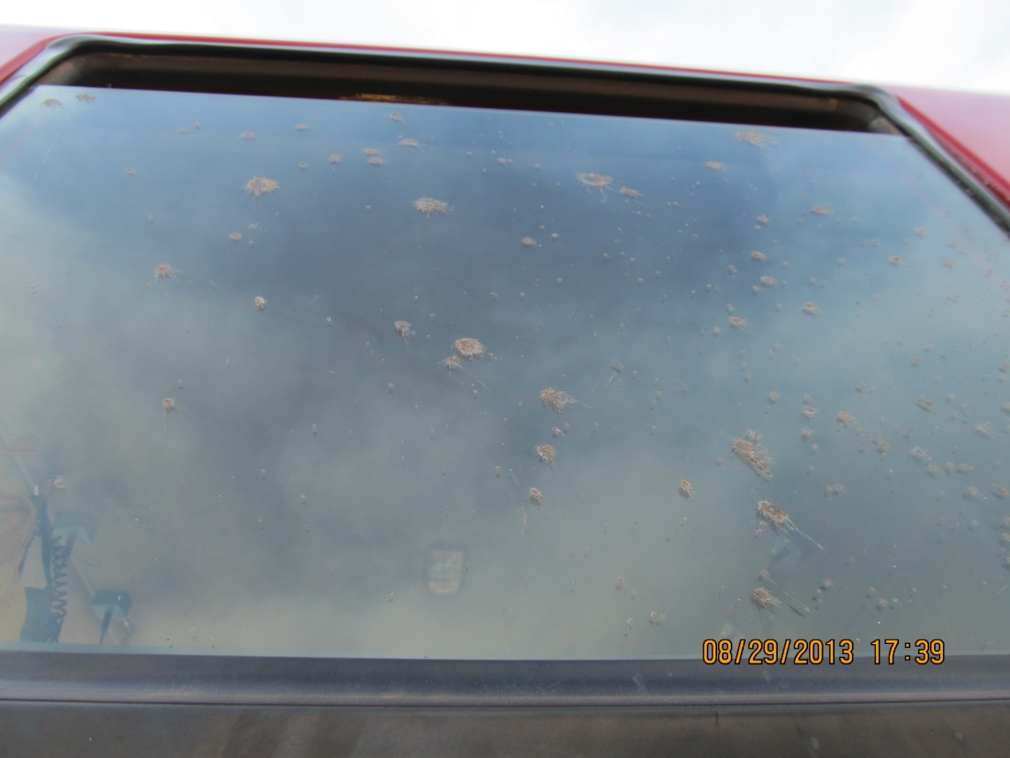
Notes:
Include the Plate and VIN number for vehicle verification. Door seal to show agency, then photos of the damage. Time and date stamps on the photos are helpful.

Slide 78
Comp/Claims Process
Complete formal documentation (cont.)
Complete agency specific Comp/Claim form (Federal, State)
Different forms for different agencies and some require their specific form

Slide 79
Comp/Claims Process
Exhibit “H”
In order for your agency to be eligible for reimbursement of expenses related to this exhibit, the approval MUST be formally documented in writing by the approving State or Federal Agency responsible for said incident. ICS Form 213

Slide 80
Comp/Claims Process
Exhibit “H” (cont.)
The formal approval must be DOCUMENTED on a General Message Form ICS-213 and Resource Order of the associated “S #” validating the expense(S)
The General Message Form ICS-213 MUST be signed by the Finance Section Chief, Incident Business Advisor, or the Incident Commander
NOTE: S#’s should ONLY be issued when the incident cannot accommodate the expense and all other options to provide the expense(s) has been exhausted.

Slide 81
Notifications
INCIDENT SAFETY OFFICER
OES AREP
COMP/CLAIMS
HOME AGENCY
Operational vs. Administrative/Paperwork
Notes:
Division, Safety for Operational

Slide 82
Accident/Claims Process
INCIDENT/ACCIDENT
STD 270
COMP/CLAIMS
APPROVED
UNAPPROVED
DOCUMENTATION
NARRATIVE, S#, 213, 214’s, PHOTOS
REBUTTAL PROCESS PER CFAA
PROVIDE ALL DOCUMENTATION
TO OES AREP

Slide 83
Other Reimbursements Thru the F-42 Process
Any incident approved expense.
Example: Motels approved to finish your travel leg home.
Must have copies of all documentation from the incident.
Must mail in receipts and documentation so the invoice can reflect the expenditure.
In-State Travel Form (OES Web site)

Slide 84
Expectations at Incident Base
What to do if you have problems
Incident Commander
Information Officer
Liaison Officer
Agency Representatives
Safety Officer

Slide 85
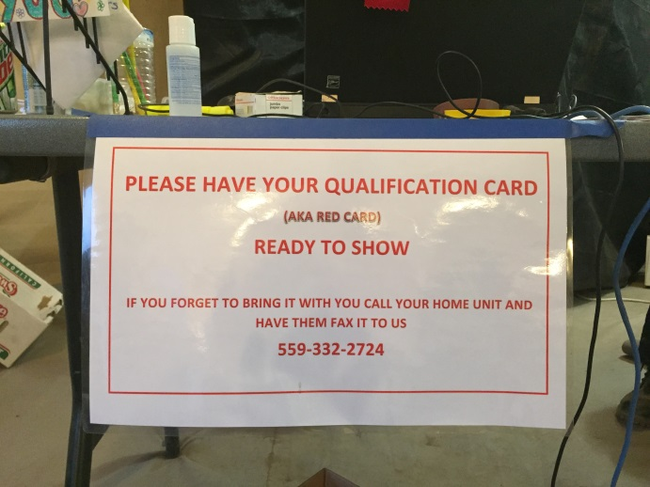
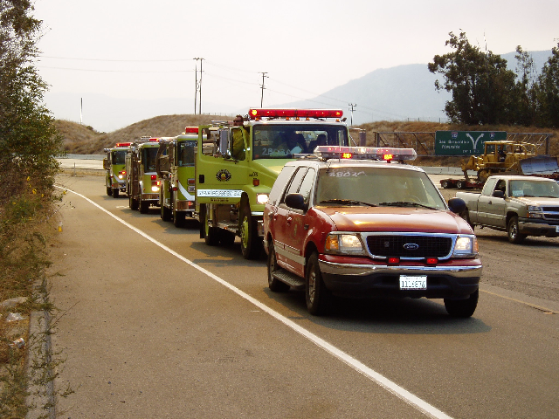
We expect you to….
Gather Dispatch Information
CICCS Qualification
Determine Urgency
Appropriate STEN Vehicle
Always Fill STEN Trainee
"Flight Following” with Operational Area
Daily “SIT STAT” with
Home Region
Notes:
STL (T) is approved for every assignment.
Discuss Leader’s Intent and CICCS Qualification Expectation

Slide 86
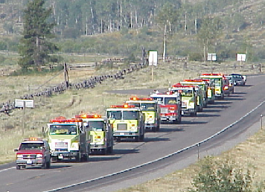
Determine Urgency
Response Modes
Initial Attack
Just like receiving a 911 call
Immediate Need
30 minute response expectation
Planned Need
1 hour response expectation
Notes:
Explain the difference between Immediate and planned need.

Slide 87
Build your file
Keep and make copies of everything
Obtain copies of everyone’s F-42
Get all the ICS Form 214’s
FILE THEM FOR 5 YEARS
Any issues that arise, the Strike Team Leader is the contact person
Notes:
Strike Team Leader expectations, OES does not require ICS 214’s

Slide 88
Cal OES Assistant Chiefs
Region I Dave Stone (916) 642-3827
Region I Vacant
Region II Vacant
Region II John Salvate (707) 853-6150
Region III Ken Hood (916) 642-3887
Region III Vacant

Slide 89
Cal OES Assistant Chiefs
Region IV Corey Zander (916) 712-6771
Region IV Vacant
Region V Bill Bondshu (559) 284-1580
Region V Javier Lara (559) 412-1016
Region VI Art Torrez (916) 642-3838
Region VI Pete Mercado (619) 302-5360

Slide 90
Cal OES Region VI
Assistant Chiefs
Art Torrez art.torrez@caloes.ca.gov
(916) 642-3838 cell
Pete Mercado pete.mercado@caloes.ca.gov
(619) 302-5360 cell

Slide 91
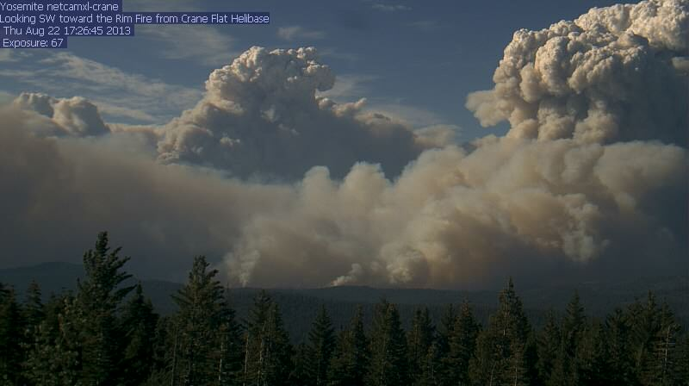
Cal OES State Warning Center
(916) 845-8911
Ask for FIRE Duty Officer
Governors Office of Emergency Services
OES - Fire & Rescue Branch

